Slide 1

Bahcesehir University
Capstone 4992
Project Title & ID
Object Recognition for Security Automation 1010667
Students
Ekin Özkurt
Berk Ultav
Beyza Albayrak
Elif Tutar
Ege Anıl

Slide 2
Introduction
Objective
  To ensure security by identifying objects registered in our dataset that can be found indoors and classifying the objects
Technologies Used
  Python
  OpenCV
  Arduino

Slide 3
Framework
Object Recognition
Python, OpenCV, Detecto
Arduino
For alarms and indicator
User Interface
For vieving detected objects and users
Database
SQLite3 based database for storing data of detected objects

Slide 4
Object Detection
A table consisting of objects that we usually carry and hold outside in daily life and that we can perceive and recognize from the CoCo database
Those with bold fonts which has the highest detection rate as a result of our experiments will be used in practical presentations
Safe Objects
Dangerous Objects
  Scissors and knife
bottle | cell phone | scissors | knife
mouse | sports ball | keyboard | backpack
book | wine glass | spoon | frisbee

Slide 5
Database Management
Storage
SQLite3 Database
Logged Information
Object name
Detection time
Classification
(Safe Object or Dangerous Object)

Slide 6
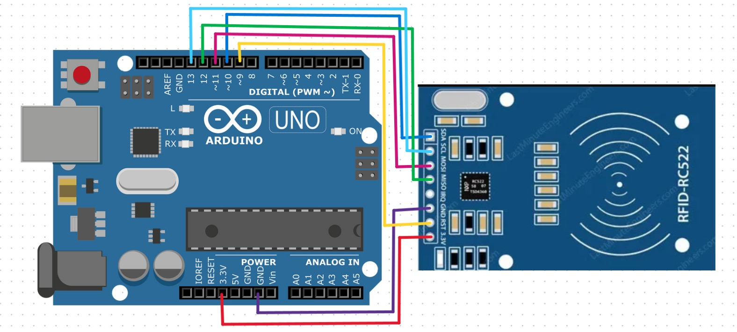
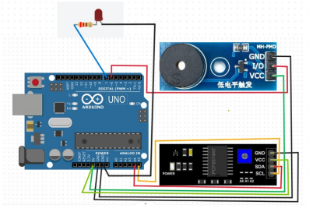
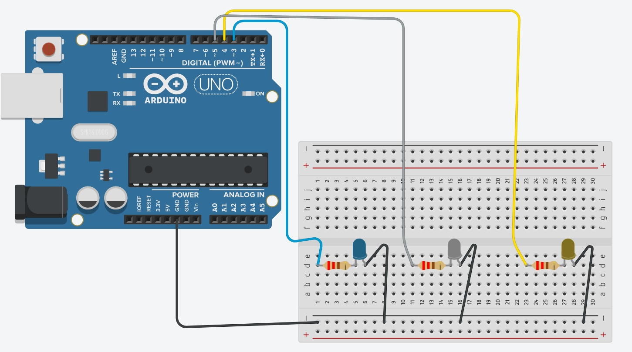
Arduino
There are two Arduinos are used in our project. Both of the communication are ensured by serial cable connection with computer. COM9 works only when ‘dangerous object’ is detected. COM12 works when security personnel uses RFID cards.
Arduino COM12 RFID
Arduino COM9
Arduino COM12 LEDs

Slide 7
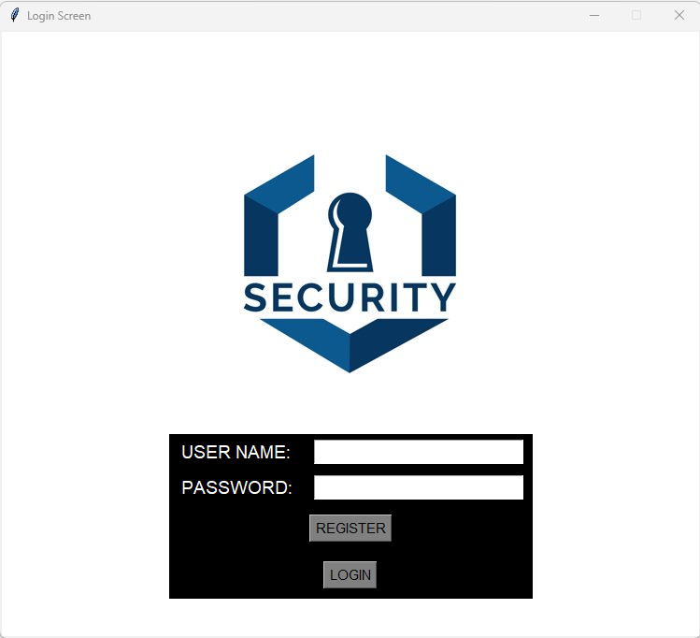
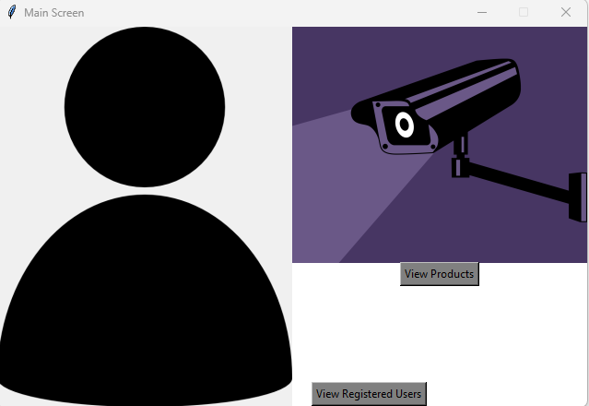

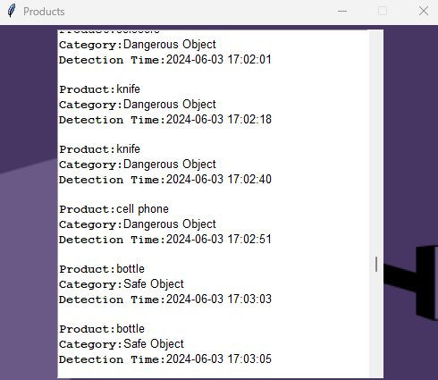
User Interface
Features
  List of detected objects
  User management
  Admin capabilities
    Remove users from system

Slide 8
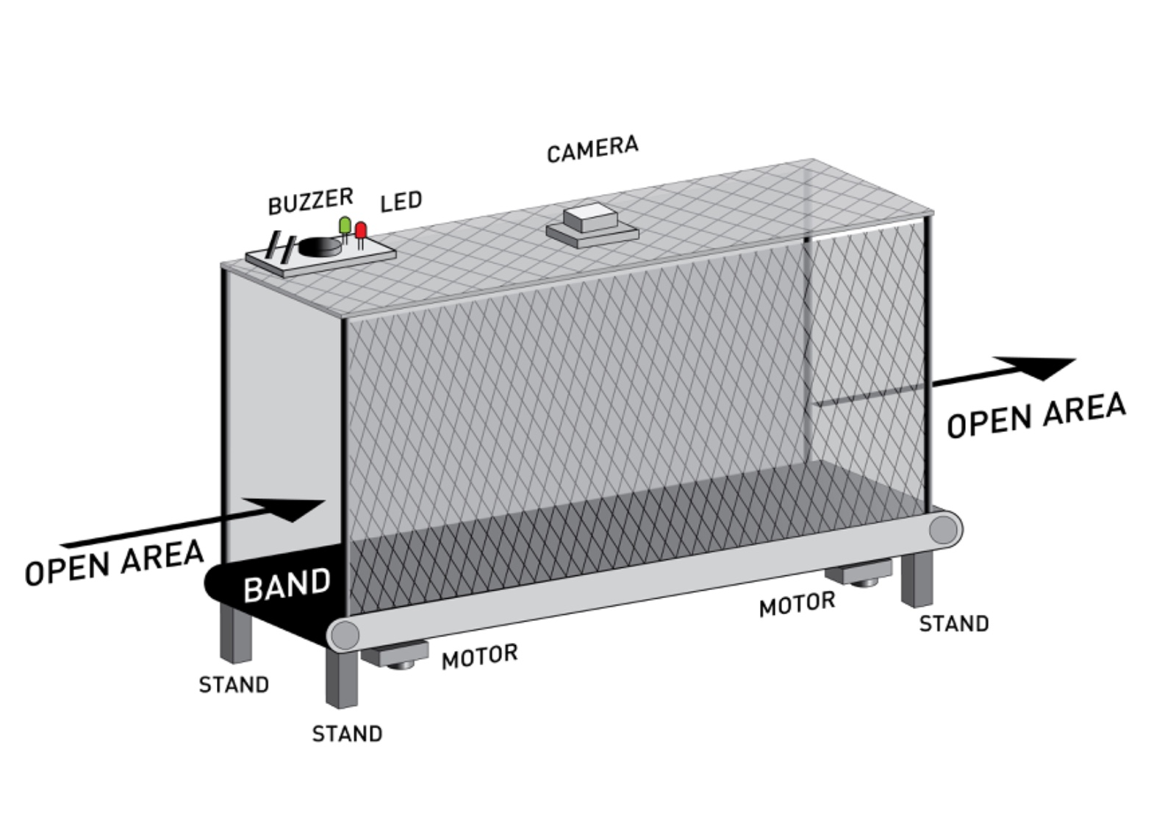
Conveyor Belt System Integration
Conveyor Belt Operation
Controlled by motor switches
Inside strip led for correct light for detection

Slide 9
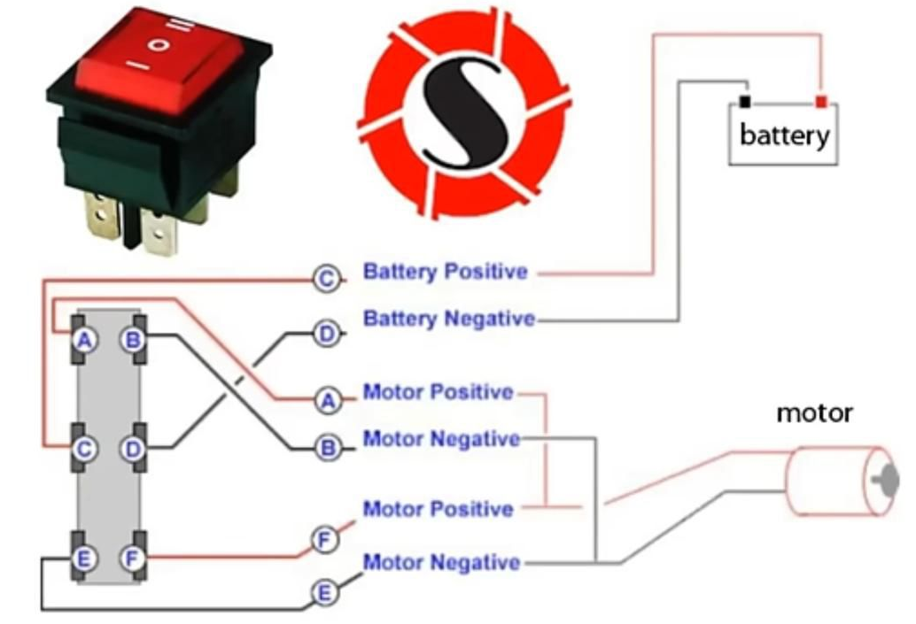
Switch Integration
Our conveyor system uses a three-position switch to control the direction of movement. The positions of the switch and their functions are as follows:
Stop Position
The conveyor stops and does not move.
Used for safety or to stop the conveyor.
Forward Position
The conveyor moves forward, towards the direction of the camera.
Allows the conveyor to move forward during normal operation.
Reverse Position
The conveyor moves backward, away from the direction of the camera.
Function: Used for situations where the conveyor needs to move in the reverse direction

Slide 10
System Workflow
Image Capture
Camera captures images of objects on the conveyor belt
Object Detection
Objects are recognized and classified using Python with libraries OpenCV and Detecto
Database
Detected objects are saved into the SQLite3 database
User Interface
Users can view detected objects and manage user profiles
Arduino
One of Arduino triggered if dangerous object is detected
Other Arduino is making easy Access to User Interface with RFID

Slide 11
Conclusion
Achievements
  Successfuly integrated object recognition with security automation
  Effective alarm and notification system for dangerous objects
  Moving conveyor belt for making realistic system

